Slide 2
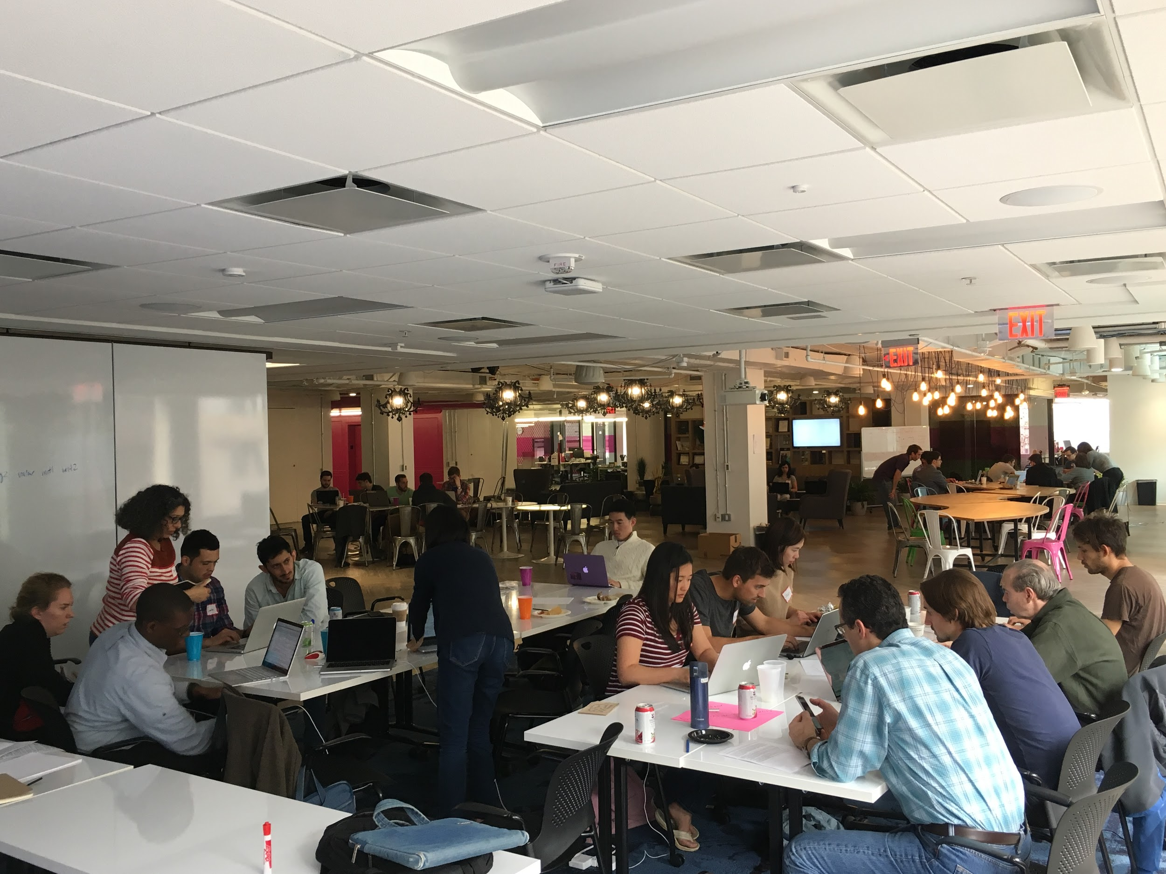

Welcome to
October 2022
DataDive at Georgetown!

Slide 3
Get Connected
SSID: HoyaHacks
PW: HOYAHaxa
Join us on Slack at: https://dkdc.herokuapp.com/
Channels to Join for this event:
#general - for overall DKDC communication and updates
Project Channels:
Save the Children: #save-october-datadive
Education for Employment: #educationforemployment
GET Cities: #getcitieschicago
Starting WIth Today: #startingwithtoday

Slide 4
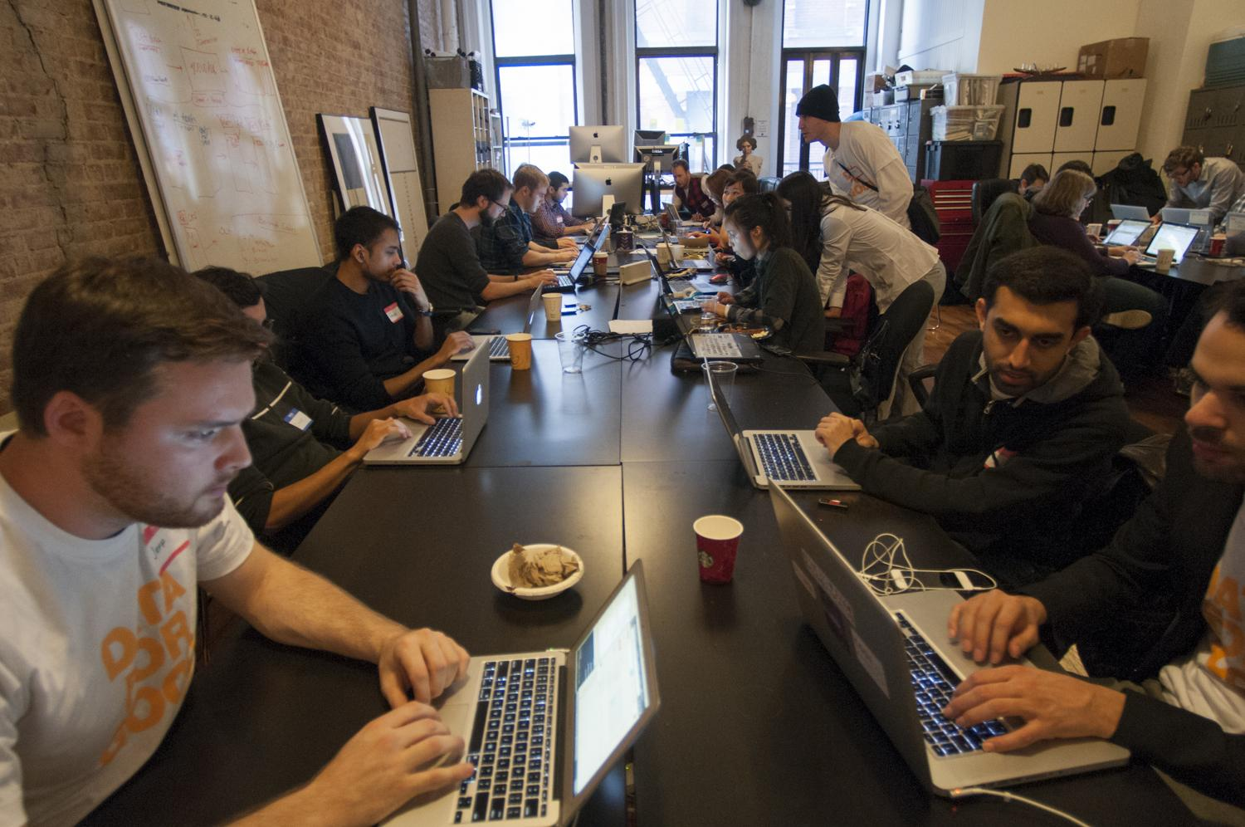
Welcome to the DataKind Community
DataKind harnesses the power of data science in the service of humanity
p
Notes:
SPEAKER: William
Datakind harnesses the power of data science in the service of humanity.
Mission-driven organizations often collect data, but often lack the capacity to gain insights and build their capacity from that data.
We create teams of pro bono data scientists who work together with these organizations to understand the need, find a solution, and collaborate to tackle the problem with data science.
Organizations get a solution they can use along with an education in data science, our volunteers get real world experience and the warm fuzzies, and we all get to live in a better world.
Which is to say, we’re in a movement together: data for good.

Slide 5
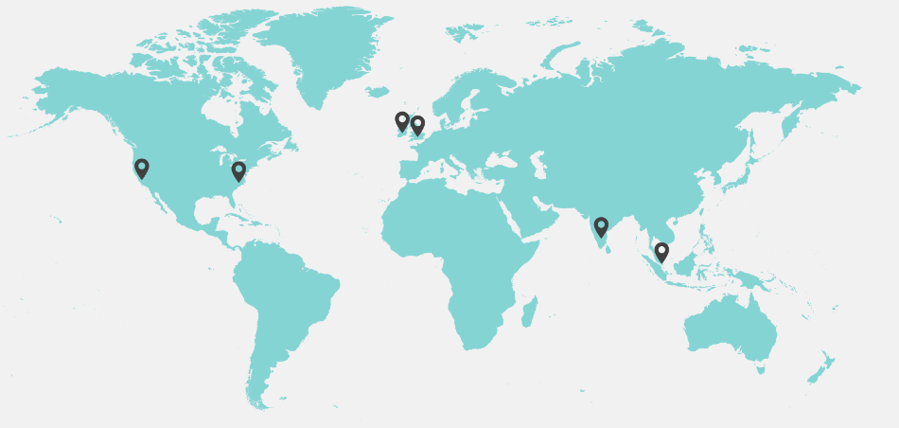
Welcome to the DataKind Community
DataKindDC has 3,000+ members on Meetup
And is part of a global chapter network
HQ in NYC | Washington, DC | San Francisco
United Kingdom | Bangalore, India | Singapore
Notes:
SPEAKER: William

Slide 6

Thank you to our hosts!
Special thank you and shout out to:
Notes:
SPEAKER: William

Slide 7
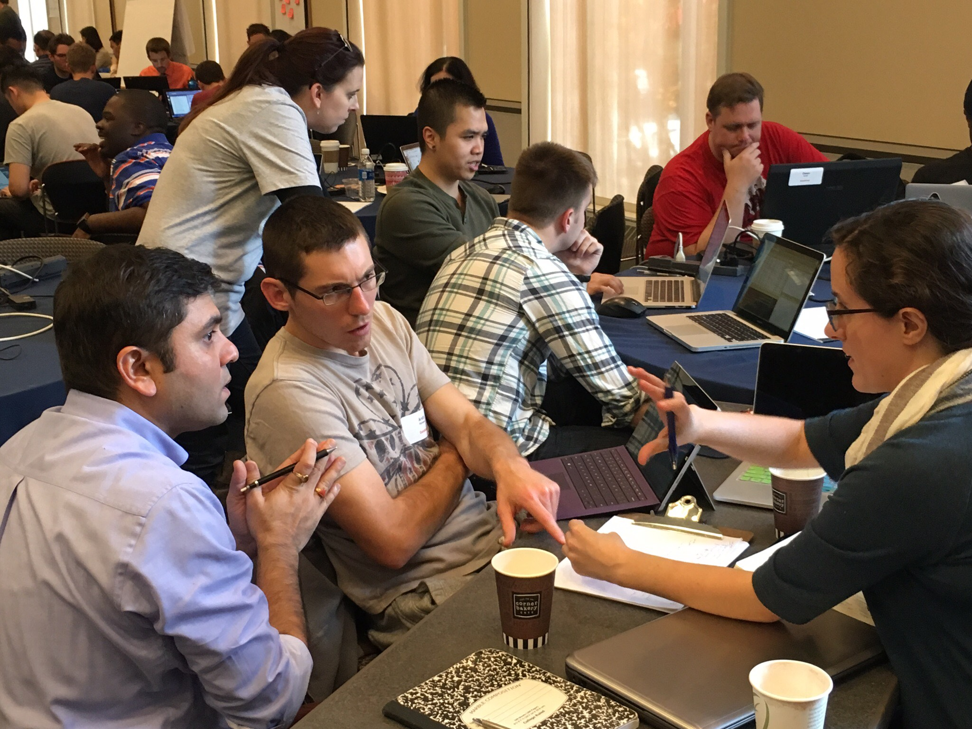
What is a DataDive?
Notes:
SPEAKER: Rich
http://www.datakind.org/datadives
Data science community + social organization + knowledge experts
Tackle tough data problems
Promote learning about new skills and methods in data science
Sharing and Collaboration

Slide 8
Data Dive Schedule
9:30 am – Volunteers arrive; bagels and coffee served
10:15 am – Introductions to DataKind and the individual projects
11:00 am – Begin work on projects for two-hour morning session
1:00 pm – Lunch is served
2:00 pm – Resume work on projects for two-hour afternoon session
4:00 pm – Regroup to present progress made throughout the day and next steps
5:00 pm – Event ends
Notes:
Rich

Slide 9
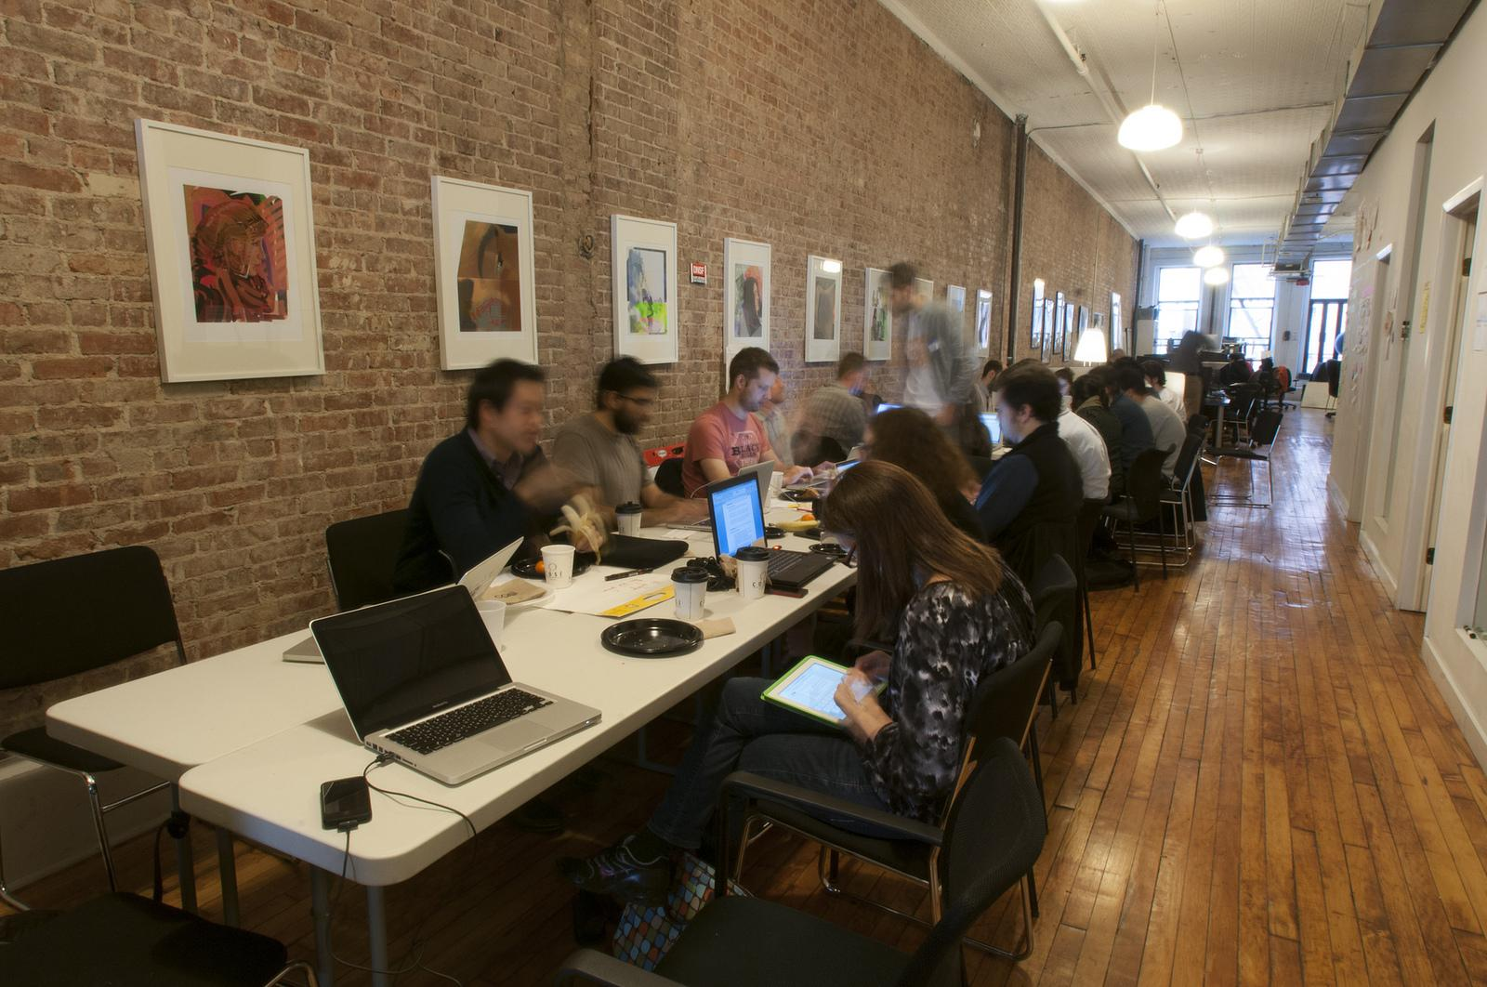




Project Pitches
Meet your Data Ambassadors & Partner Organization Representatives
Notes:
SPEAKER: Aimee

Slide 10
Partner Org Rep: Rose Data Ambassador: Sneha, Katie, Taylor

Slide 11


Working to build a more inclusive future in tech, starting at the city level.
Notes:
Thanks so much to the team at Datakind and our mighty team of collaborators for making time today.

Slide 12


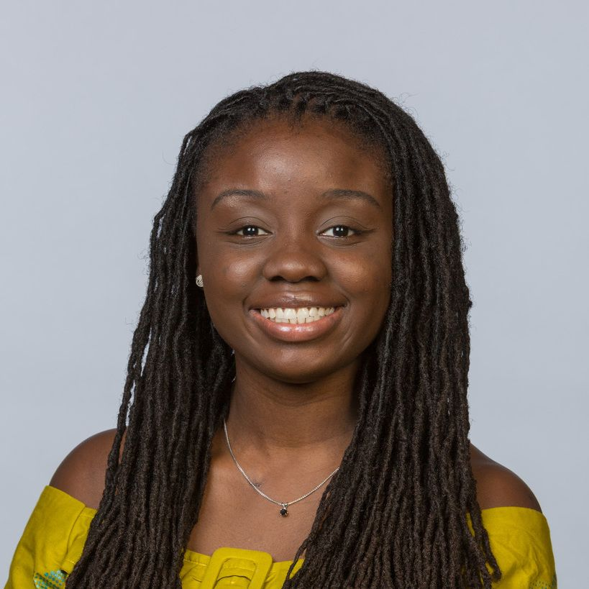




^{Introducing:}
Serwah (^{Rose) Afriyie}
^{GET E}ntrepreneur-in-Residence
Notes:
My name is Rose Afriyie and I am the Entrepreneur-in-Residence in GET Cities. My background is in social impact across the private, public and nonprofit sector. I am also the co-founder of a Chicago based team mRelief a majority-woman and nonbinary public interest technology nonprofit that has connected more than 1.3 million families across the US to food assistance and unlocked $1 billion in food stamps. At GET Cities I lead our landmark study exploring why women churn and stay in technology in the Chicagoland area.

Slide 13
^{Gaps in Analysis}
Problem: Understanding Churn & Retention
Regional focus to develop localized solutions
Marginalized groups: Centering women along with Nonbinary and Transgender people as well as Black and Latinas
Women at multiple stages in their career
2021 resulted in 18.2% fewer tech women brought into organizations, with 11.3% of women leaving the tech sector according to the Anita Borg Institute for Women.
Notes:
Before starting our own research, we did literature review of national studies and learned between 11.3 percent and 41% of women are leaving technical roles. But we also identified some important gaps or areas of opportunity for us to incorporate in our study. 1. we think it’s a strength to look squarely a region to develop localized solutions to issues of women exiting. 2. Very few studies currently center women along with nonbinary and transgender folks. In addition, landmark studies are still trying to incorporate the lens and perspective of Latinas and Black women. And instead of focusing on women at one point in their career, we want to focus on women at multiple stages.

Slide 14


^{HOW IT WORKS}
01
Survey
We are collaborating with Chicago organizations on a survey to engage 380 WTGN technologists on needs.
Solution: An Initiative to Empower Technologists
GET Cities is leading a community initiative to understand the experiences of Women, Trans and Gender Non-Binary (WTGN) Technologists in the Chicagoland area to inform our future work to prevent churn.
02
Mentorship
We aim to pilot a more effective mentorship program to help prevent churn.
Notes:
We think of our study as partly research and partly a community initiative because we have built a coalition to do this work and have incorporated their feedback and the feedback of technologists as we have iterated on our efforts. Our initiative to empower technologists and prevent churn features 2 components: 1. A survey we are conducting to engage 380 WTGN technologists. 2. An innovative mentorship program informed by what we learn.

Slide 15




Closed Community Partners
Gender Equality in Tech (GET) Cities is an initiative designed to accelerate the representation and leadership of women, trans and non binary in tech through the development of inclusive tech hubs across the United States.
NSBE supports and promotes the aspirations of collegiate and pre-collegiate students and technical professionals in engineering and technology. With more than 1600 members in Chicago, NSBE’s mission is “to increase the number of culturally responsible black engineers who excel academically, succeed professionally and positively impact the community.”
Latinas in Tech is a non-profit organization with the mission to connect, support and empower Latina women working in technology. With more than 700 women in the Latinas in Chicago Facebook group, Latinas in Tech Chicago connects and supports the professional career growth of Latinas in the Chicago area.
Notes:
Along with galvanizing are own internal teams, we closed NSBE Chicago and Latinas in Tech Chicago in Q1 to engage in thought partnership and distribution across their networks.

Slide 16
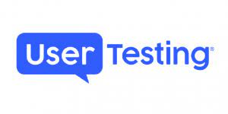


Closed Survey Design + More Community Partners
UserTesting.com is a company that believes that the path to human understanding starts with shared insight— seeing and hearing how another person engages with the world around them and taking in their perspective. UserTesting's One World Program helps charitable organizations dedicated to humanitarian and inequality related causes increase their impact through free user tests, support and resources. In Q2, we completed 150 surveys through this partnership.
Muslim Women in Technology aims to create a network for current and future female leaders across all industries by developing connections, learning together, and sharing opportunities for career advancement. Their vision is to support, empower, and increase the confidence of Muslim women and other marginalized groups in a tech-centric world.
The Society of Hispanic Professional Engineers (SHPE) has a mission changes lives by empowering the Hispanic community to realize its fullest potential and to impact the world through STEM awareness, access, support and development.
Notes:
And by Q3, we onboarded UserTesting to curate our survey respondents from among their pool of technologists in the midwest. Together they have referred more than 150 respondents toward our efforts.

Slide 17
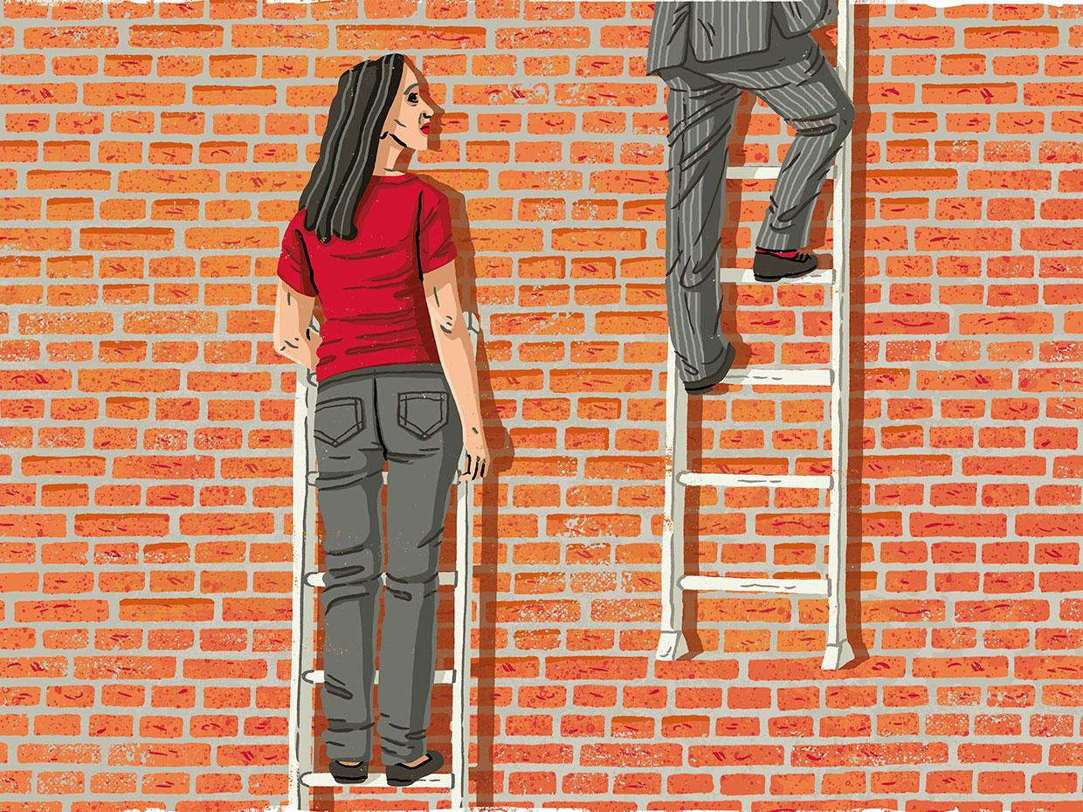
T
What we’ve learned so far: Promotions are an area for disruption
“I'd say it's the same as other industries. Men are rewarded more in terms of salary and movement upward in the organization.”
“In my last place of employment women were not told of open jobs that the management saw as "men's" positions.”
“As a woman, my experience has been challenging. Technology careers typically are dominated by males. The expectations for women in this role tend to be that we ‘don't know what we're doing,’ or ‘we don't have as much creativity.’ Tend to be overlooked for a lot of projects, and promotions.”
Notes:
We have reached more than 406 women, trans and nonbinary technologists in the Chicagoland area and would love your help to delve into the experiences of technologists in the region.

Slide 18
Your Role: Skills Needed
& Today’s Priorities
Notes:
Skills - NLP - sentiment analysis for open ended questions, people who can helps us visualize graphs, and also Pivot tables and excel.
The priorities are highlighted in peach.
I will be here all day if there are any questions.

Slide 19

Data Science Team Mission
Parsing and analyzing survey data to understand trends in workplaces among women and queer people who stay and leave tech fields in Chicagoland
Trends we’re curious about: advancement/promotion, inclusion, management, compensation, parental status, and representation
Using results to create a report and influence design of new mentor initiative to support Chicagoland area technologists
Guiding Questions
What is the gender and racial breakdown of survey respondents and how do experiences differ?
How do the experiences of full-time and contracted workers differ?
Of technologists who plan to leave their roles, what reasons do they provide?
Notes:
SPEAKER: <Sneha>

Slide 20
Goals for today (in order of importance)
Exploring and cleaning data
Skills: Data wrangling (R or Python, any experience)
Data visualization and dashboarding
Skills: Data wrangling, cleaning, visualizing (some experience is useful but not required)
Sentiment analysis of open ended questions
Skills: Natural Language Processing (R or Python, some experience is useful)
Notes:
SPEAKER: <Sneha>

Slide 21

Thank you!
serwah.afriyie@gmail.com
Notes:
Thanks so much for your time.

Slide 22

Partner Org Rep:
Charlyn
Data Ambassadors:
Alex, Juan, Glenn
Notes:
SPEAKER: <name>

Slide 23
Overview
Starting With Today Mission
“To create, sustain, and enhance professional, mental, and financial wellness by providing customized training and resources to underserved adults.”
Data Science Team Missions
Maximize event success by determining the optimum event locations and types in the District of Columbia, Maryland, and Virginia (DMV) region.
Enable SWT expansion efforts by determining which factors predict event success and indexing the DMV region accordingly.
Identify ways to integrate and leverage success with partner organizations and funders.
Notes:
SPEAKER: <name>

Slide 24
DataDive Goals
SWT Dataset Exploration
Analyze YoY growth in participants served, participants served by event type, and number/type of service partners.
Summarize demographic characteristics of participants.
Summarize participant workshop interests and post-workshop feedback.
Skills: Data wrangling, data visualization, Python (or R)
External Dataset Exploration
Identify publicly available data sources at the census block or other geographical levels that relate to mental health, financial instability, unemployment, racial wealth gap, etc.
Merge data sets into one master data set used to identify SWT target service areas
Identify other culturally relevant mental health and wellness service providers in Wards 7 and 8.
Skills: Data analysis, Python (or R), GIS, Time series
Notes:
SPEAKER: <name>

Slide 25
Partner Org Rep:
John Zoltner
Data Ambassadors:
Charlotte, Amy
Notes:
SPEAKER: Nicole and Frank

Slide 26

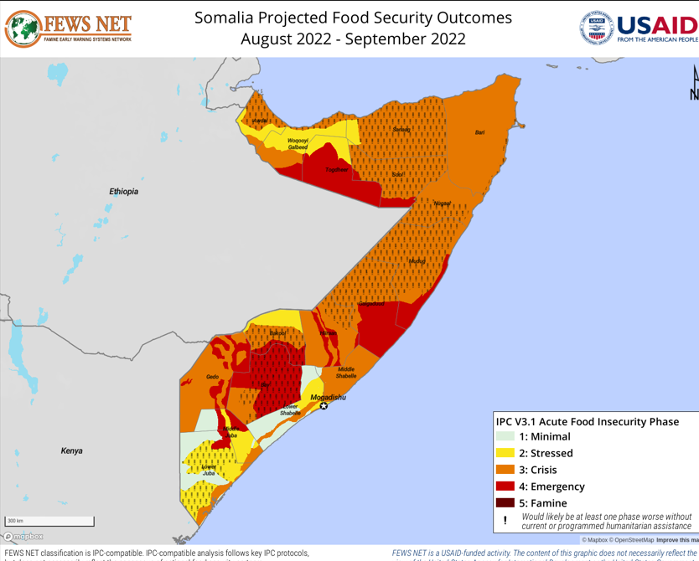
About the project:
Enhance access and interoperability of data from multiple sources about food insecurity and related needs
Develop Azure-hosted platform to automate ingestion, storage, and modeling of humanitarian data
Currently prototyping with Somalia but ultimately interested in being able to repeat work quickly in new region
Today- 45 data tables that need exploration
Today’s Objectives:
Dataset exploration (cleaning and organization)
Data analysis and visualization
Notes:
SPEAKER: Charlotte
First, a bit about the project and narrow that down to what we are hoping to accomplish today.
-DataKind, Save the Children, and Microsoft are working to enhance the interoperability between Save the Children’s internal datasets and the many open datasets that exist across geographies, services, organizations, and governments.
-The team is developing an Azure-hosted platform to automate the ingestion, storage, and modeling of a vast array of humanitarian datasets, and standardizing these into a common geospatial data format.
-This will allow the response sector to use the data to make their life-saving programming more effective.
At this junction an initial set of about 45 data tables of food insecurity and related data in mostly Somalia (with some in Kenya) has been ingested into the Azure platform. Many of them come from the ‘humanitarian data exchange’ or HDX, a website that houses tons of different humanitarian-related datasets originally from different sources. Some are geographically based- showing administrative boundaries or food insecurity maps. Others show changes over time, such as food prices. Some relate to the presence and work of humanitarian relief organizations. We need help exploring these datasets from two perspectives. First, we need help understanding how the tables are organized and relate to one another. This might not be the most glamorous task but it is one that will have the most immediate impact. Second, we need help doing exploratory data analysis with a special focus on a few questions as well as visualization. And we want to do all of this with an eye to how we can expand the work to ingest new data over the same countries or similar data over new countries.

Slide 27
Track 1: Dataset Exploration (cleaning and organization)
Example Subtasks:
Create standardized list for categorical data (ex- look up table for administrative region names)
Identify column data types
Apply Humanitarian eXchange Language (HXL) to tables
Compare table present for multiple countries
Skills: Database, SQL, Critical reading/research, Data wrangling
Track 2: Prototyping Analyses and Visualizations
Example Subtasks:
Visualize data, including geospatially and/or temporally
Analyze health care facility availability v population
Look for correlations within and between datasets
Normalize variable by population
Build predictive models of time series
Skills: Database, SQL, Python (or R), GIS, Time series, Data analysis
Notes:
SPEAKER: Charlotte
Let’s look at the two tracts in a little more detail. This is not an exhaustive list but is meant to give you an idea of what you can expect from this project today.
First, we have a few tasks that will help us wrangle the data in a more easily usable format. There are a few categorical variables, such a region names present across several tables that might be spelled differently so we need to standardize them to more easily merge the tables. We also need to know the data types of the columns. There are standards for name columns which are followed in some tables and not others, so we need help with that. And lastly, since this is ultimately work we want to reproduce with new countries, it would useful to compare the same table across countries (namely, Somalia and Kenya). This would be a great task for anyone who may not have programming skills but is good at tracking down details and synthesizing information. Other skills needed are listed here.
Second, we want to understand the data and relationships therein. Visualization will be an important part of this. This can be charts and graphs as well as geospatial and temporal visuals. We have specific questions Save the Children want us to look into. These include understanding health care facility distribution across the population, as well as normalizing other variables by population within a region. This also includes understanding correlation between variables within and between datasets. Next, we could also use help building predictive models for some of the temporal data.
For this tract we’re looking for any and all of the skills listed here (or interest in experimenting with them).
We’re excited to be here and see what we can build together to ‘Save the Children’!

Slide 28
Partner Org Rep:
Ashley Barry
Data Ambassadors:
Chuck
Notes:
SPEAKER: Ashley and Chuck

Slide 29

Education For Employment (EFE) is the leading nonprofit that trains youth and links them to jobs across the Middle East and North Africa (MENA). This pivotal region is the hardest place on the planet for youth to get their first job – they are three times more likely to be unemployed than older adults
7,000 students, 500 cohorts, 8 countries
Program applications
Pre/post program surveys
Employment history (up to 2 years post)
Predicting success in job placement and retention
Notes:
SPEAKER: <name> Predicting success: Does the program make a difference? For who?

Slide 30
Descriptives
Variable creation
Do employment outcomes vary for males and females?
Recoding
Composite variables
Data reduction
Retention vs Job Changing
Charts
Crosstabs
Dashboards
Predictive Modeling
Regression (Linear Mixed Models)
Decision Tree
Program value-added
Notes:
SPEAKER: <name>

Slide 31
Code of Conduct
“Be tough on ideas, gentle on people.”
Humble We are nothing without each other. We connect communities, and it is our mutual respect for one another that keeps us moving forward. | Sensitive and Thoughtful We are constantly sensitive to the fact that we are not just dealing with numbers, but that we are dealing with people's lives. | Approachable and Fun Whether you’re a nonprofit, a data scientist, or just someone interested in learning more, we welcome you to the DataKind community and make sure you have a great experience with us.
Transparent and Open We are completely transparent in what we do, how we create our work, how we approach problems, and how we think about the world. | Committed to Excellence People rely on our abilities and those of our volunteers, so we only accept the best and the brightest into DataKind’s staff and top ranks. We strive to continuously learn and improve. | Committed to Diversity We welcome diverse viewpoints, diverse skillsets, diverse backgrounds, diverse lifestyles, and seek variety and richness in our community.
Discrimination and harassment are expressly prohibited in our community.
Notes:
SPEAKER: Dan
One of our favorite mottos at DataKind is “Be tough on ideas, gentle on people.” People are at the center of all that we do so it’s critical that, as we strive to do excellent work, we also demonstrate mutual respect for one another and exemplify our core values in all that we do.
We are committed to providing a welcoming and safe environment for people of all races, gender identities, gender expressions, sexual orientations, physical abilities, physical appearances, socioeconomic backgrounds, nationalities, ages, religions, and beliefs.
Every member of the DataKind community is expected to work hard, be considerate of their colleagues across the community, and contribute to a collaborative, positive, and healthy environment in which we can all succeed.
Unacceptable Behaviors
Discrimination and harassment are expressly prohibited in our community. Do not make assumptions about a person’s level of expertise based on their gender, race, class, sexual identity, or gender presentation. Do not insult or put down other participants. Harassment includes, but is not limited to:
Violent threats or language directed against another person
Intimidation; stalking; unwanted photography; inappropriate physical contact
Use of hateful, sexual or discriminatory imagery, comments, jokes, or language
Sexist, racist, ableist, or otherwise discriminatory or derogatory language
Posting sexually explicit or violent material
Unwelcome sexual attention
Advocating for, or encouraging, any of the above behavior
In general, if someone asks you to stop, then stop.
Any behavior or language that is unwelcoming, would hurt someone or make them feel uncomfortable—whether or not it rises to the level of harassment—is unacceptable in our community.
If a participant engages in harassing behavior, event organizers will notify that participant that their behavior has been reported and may take any action they deem appropriate, including warning the offender and/or expulsion from the community itself.

Slide 32



Housekeeping/Knowledge Management
Documentation Project docs are located in the Google Drive folder. Data Ambassadors will make sure you have access when we split into groups. Overviews also include links to the rest of resources. | Code Commit your code to github! Each project has its own repo; DAs will set you up with the right level of access. If you don’t know what GitHub is, don’t worry, we can help! | Data We try to avoid committing data to Github. Each of the project Google Drive folders has a data folder where the data for the project is stored (or even better - links to access from source) | Communication Share your work with the rest of the team in Slack! Each project has a Slack channel. Please join (link below). Work will continue here after today!
Notes:
SPEAKER: Rich

Slide 33
Housekeeping/Knowledge Management
Slack If you haven’t already, please join our Slack at dkdc.herokuapp.com There are channels for each of today’s projects, with the resources pinned in a post at the top. The channels are: Save the Children: #save-october-datadive Education for Employment: #educationforemployment GET Cities: #getcitieschicago Starting WIth Today: #startingwithtoday
Notes:
SPEAKER: Rich

Slide 34
Data Dive Schedule
9:30 am – Volunteers arrive; bagels and coffee served
10:15 am – Introductions to DataKind and the individual projects
11:00 am – Begin work on projects for two-hour morning session
1:00 pm – Lunch is served
2:00 pm – Resume work on projects for two-hour afternoon session
4:00 pm – Regroup to present progress made throughout the day and next steps
5:00 pm – Event ends
Notes:
Rich

Slide 35
Share screenshots and tweets
#DataDive
@DataKindDC
Share screenshots and tweets
#DataDive
@DataKindDC
Notes:
SPEAKER: <name>

